Slide 1
React Native Bootcamp
Lesson -1. ES6

Slide 2

ES6 new features
Arrow functions and lambdas
Iterators and Generators
Modules
Proxies

Slide 3
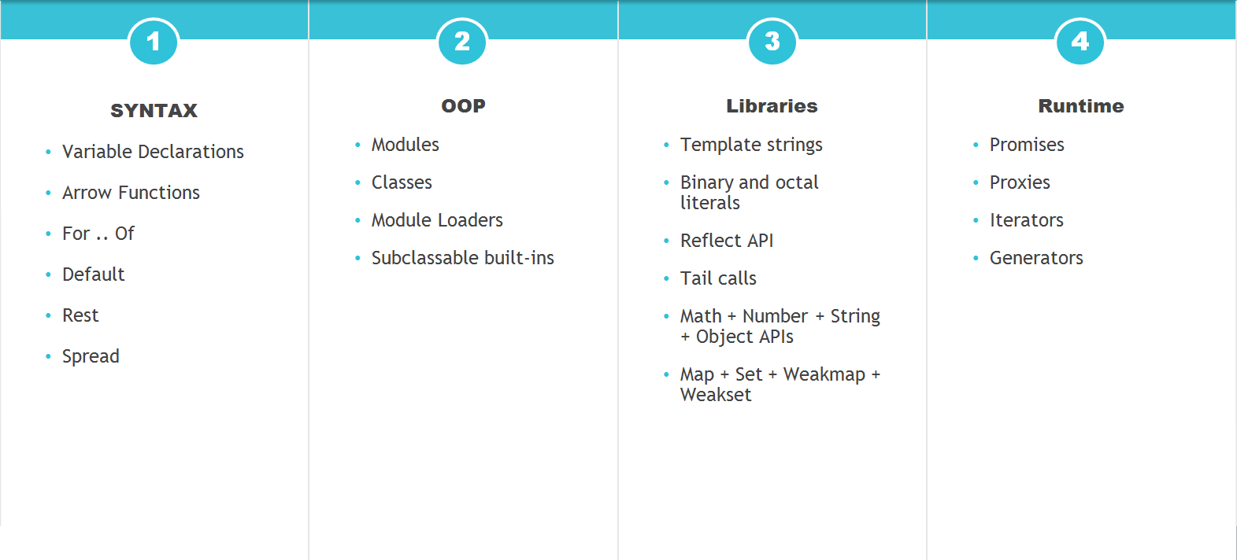
ES6. What is new?

Slide 4
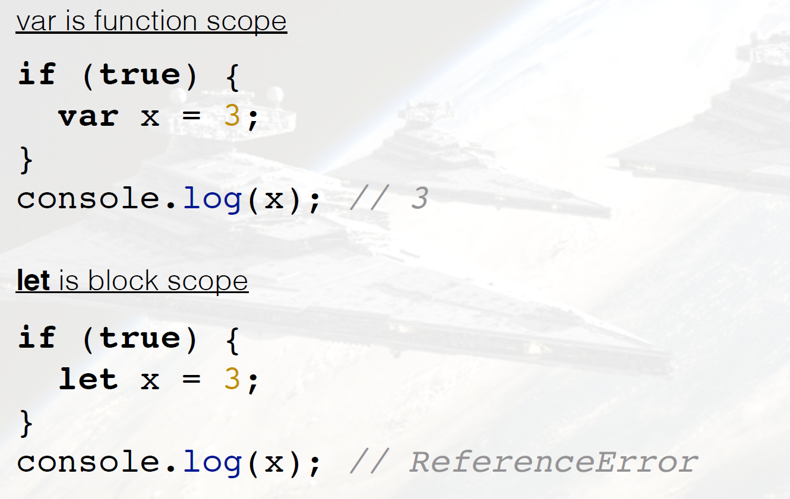
Declaration and Scoping

Slide 5
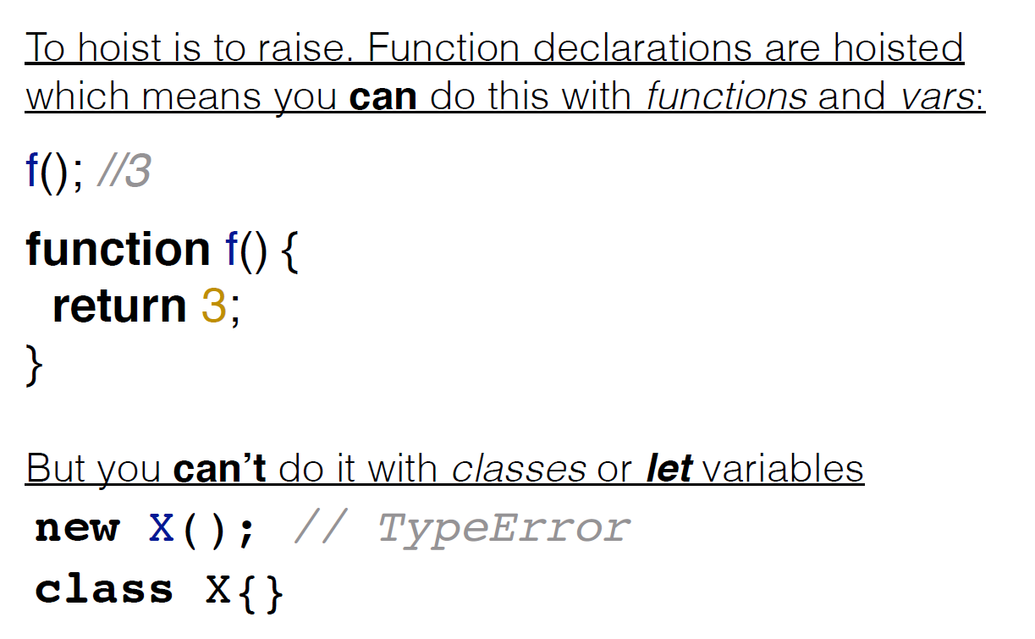
Declaration and Scoping

Slide 6
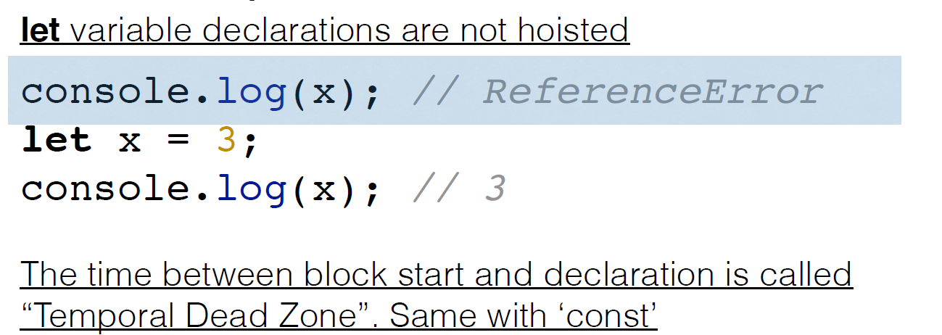
Temporal dead zone

Slide 7
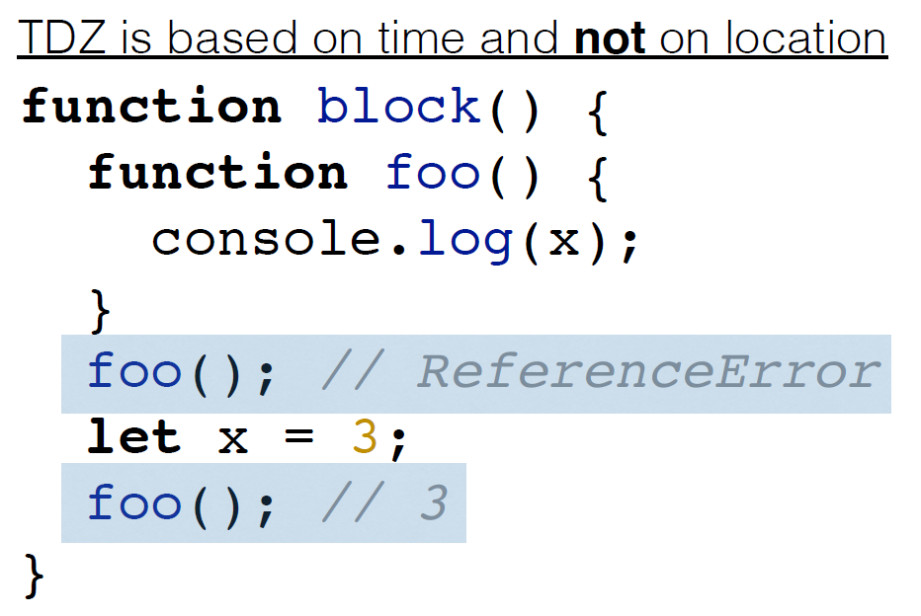
Temporal dead zone

Slide 8
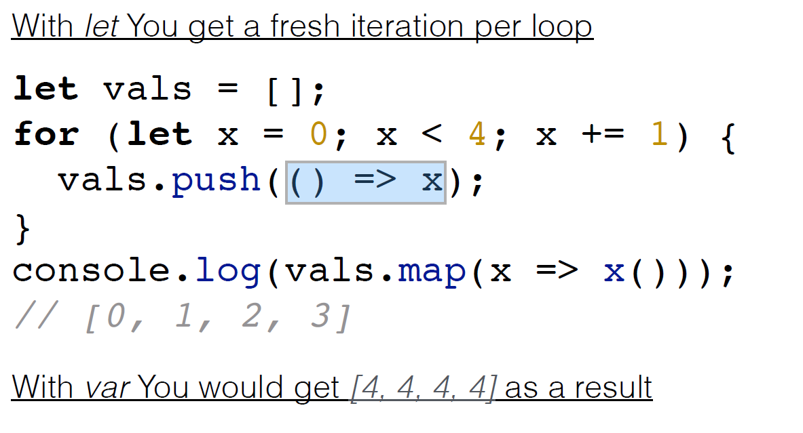
Loop scoping

Slide 9
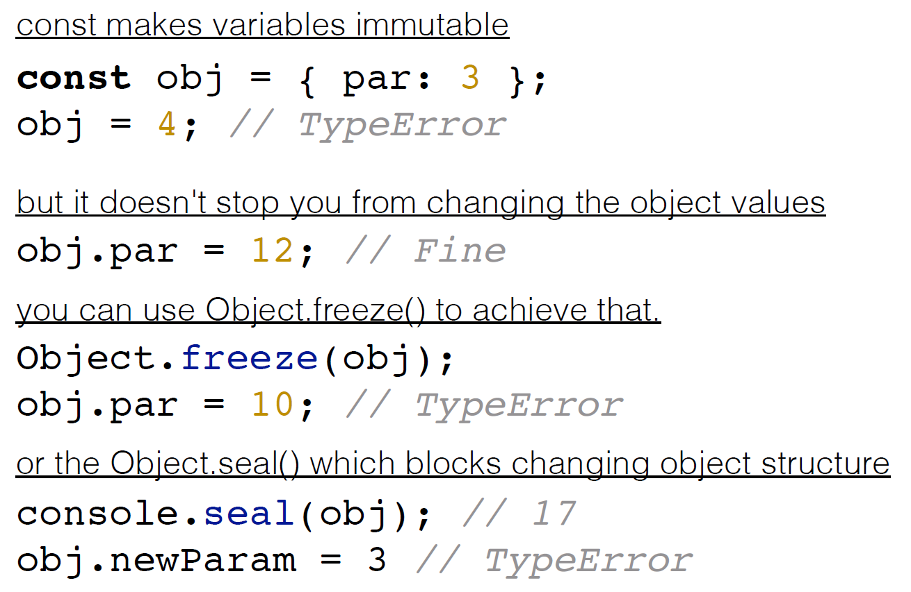
Constants

Slide 10
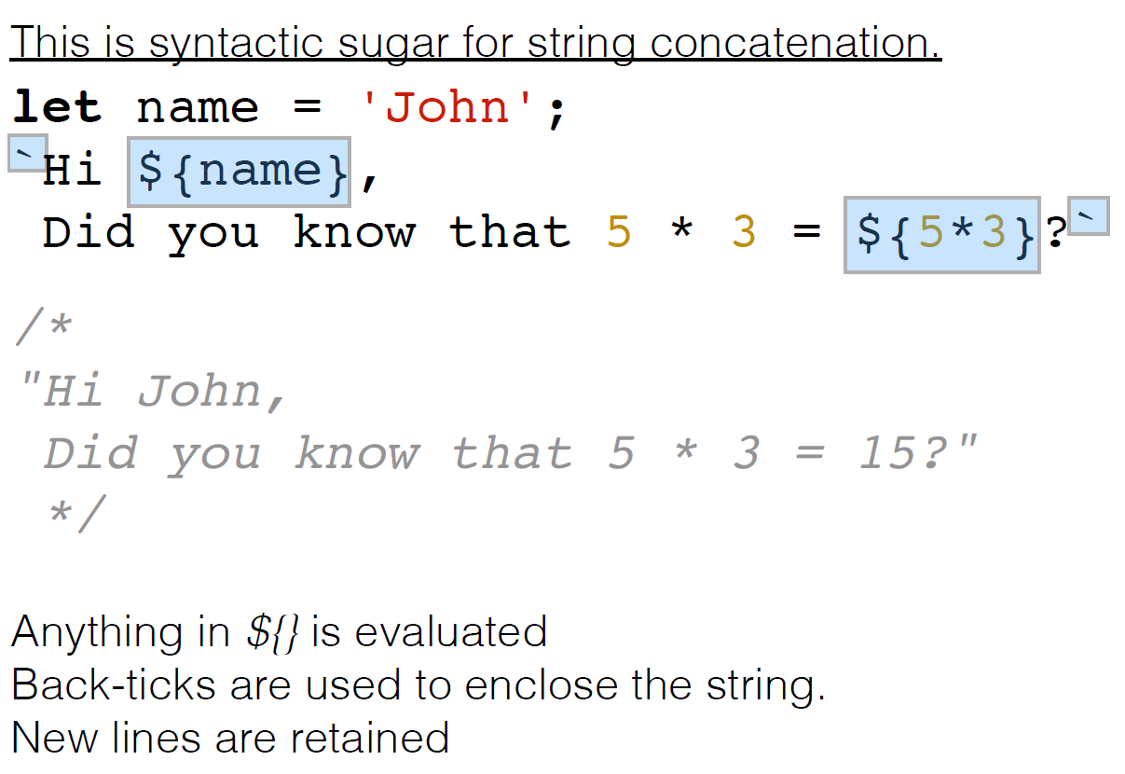
String templates

Slide 11
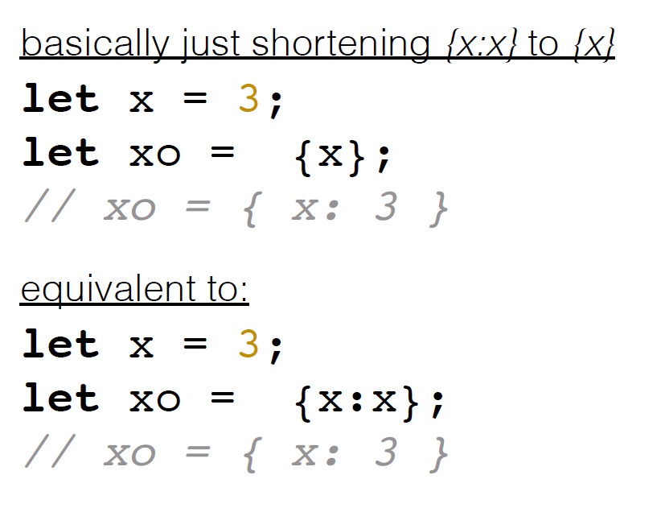
Enhanced object literals

Slide 12
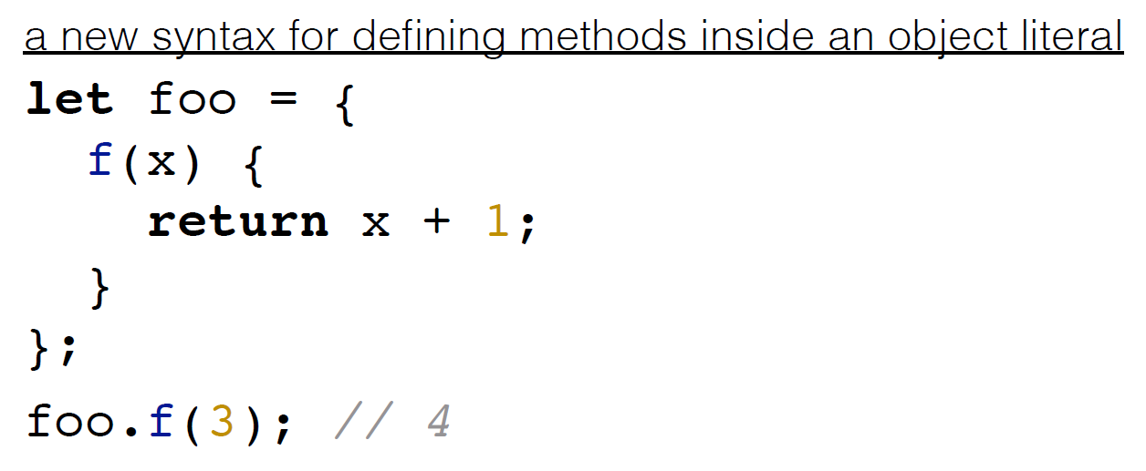
Method definition

Slide 13
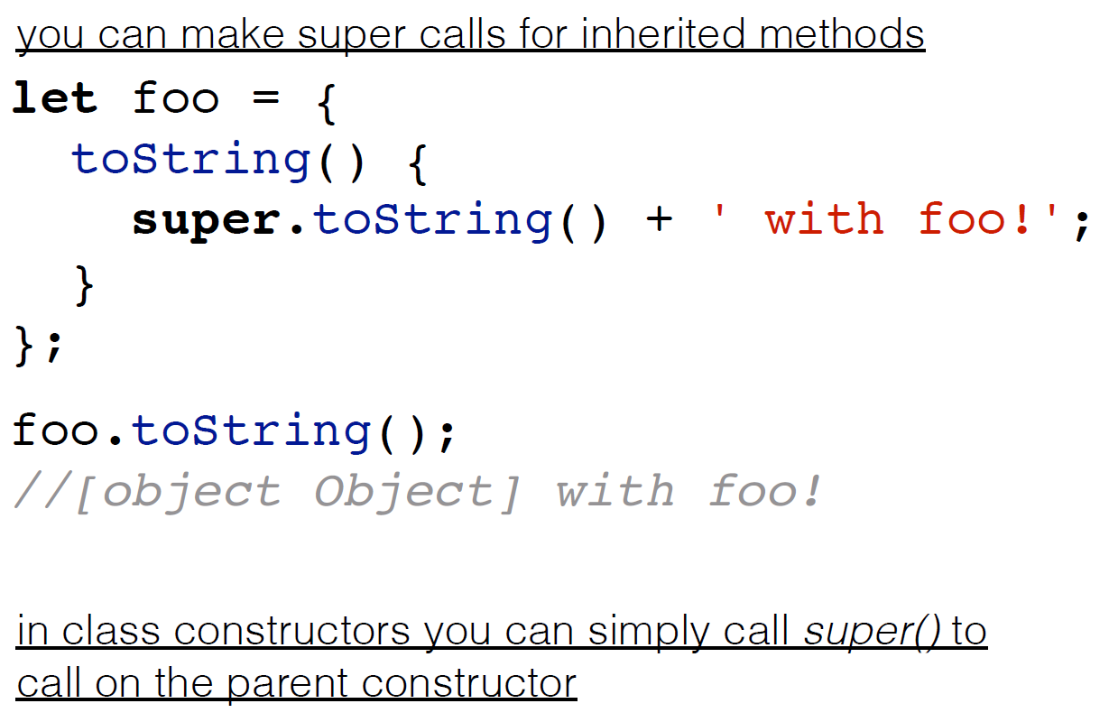
Super

Slide 14
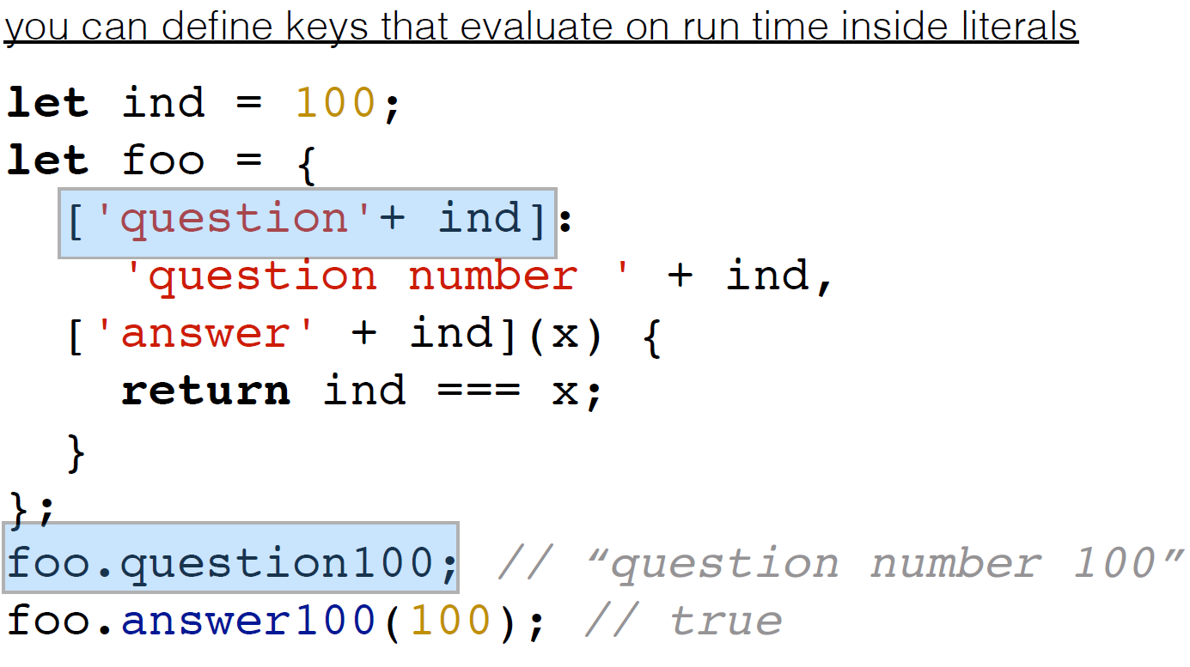
Computed properties

Slide 15
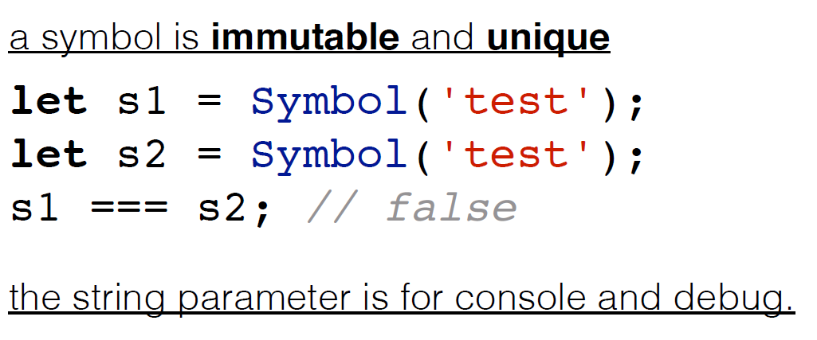
Symbol

Slide 16
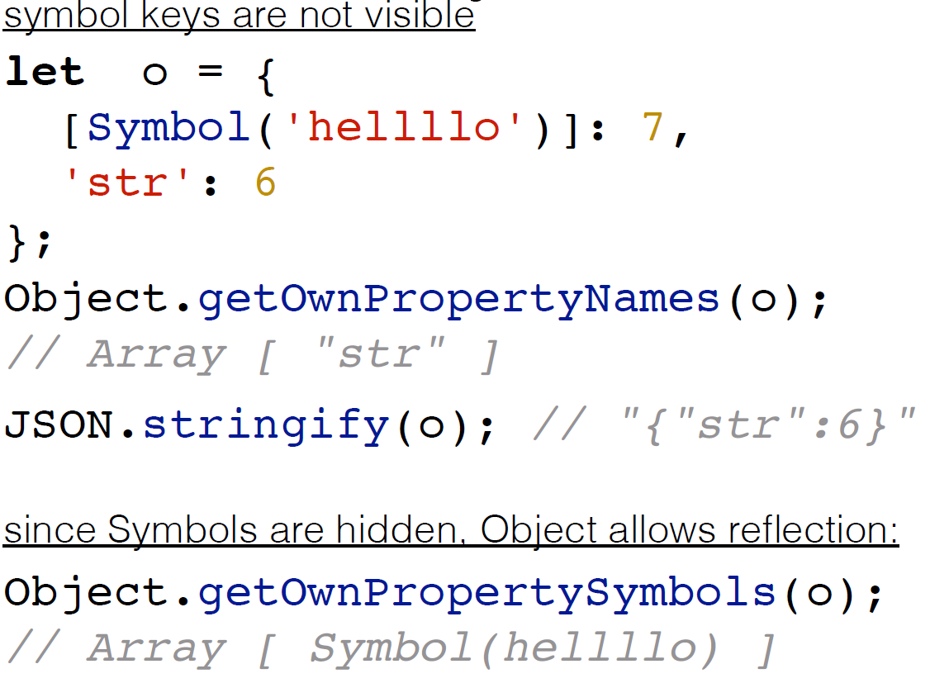
Symbol

Slide 17
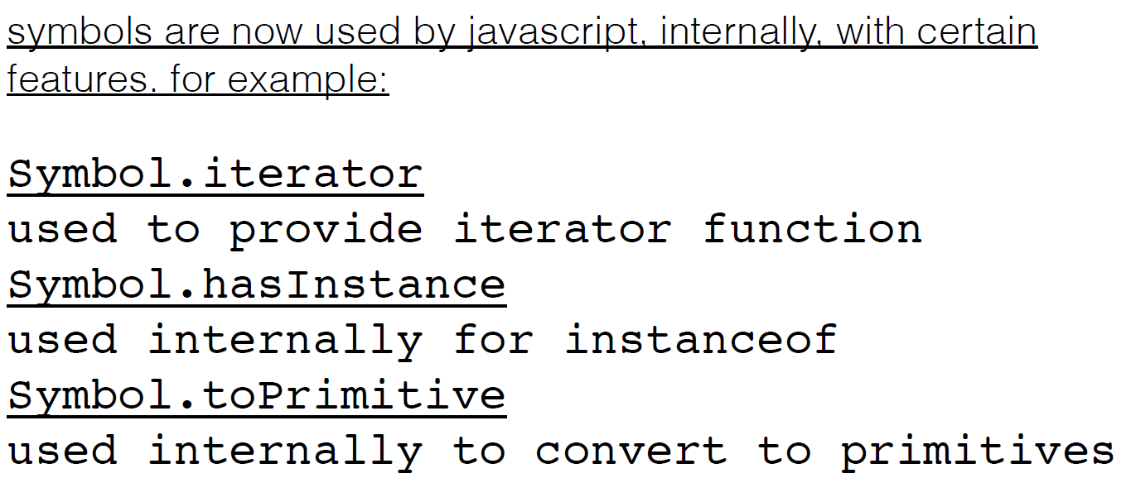
Symbol

Slide 18
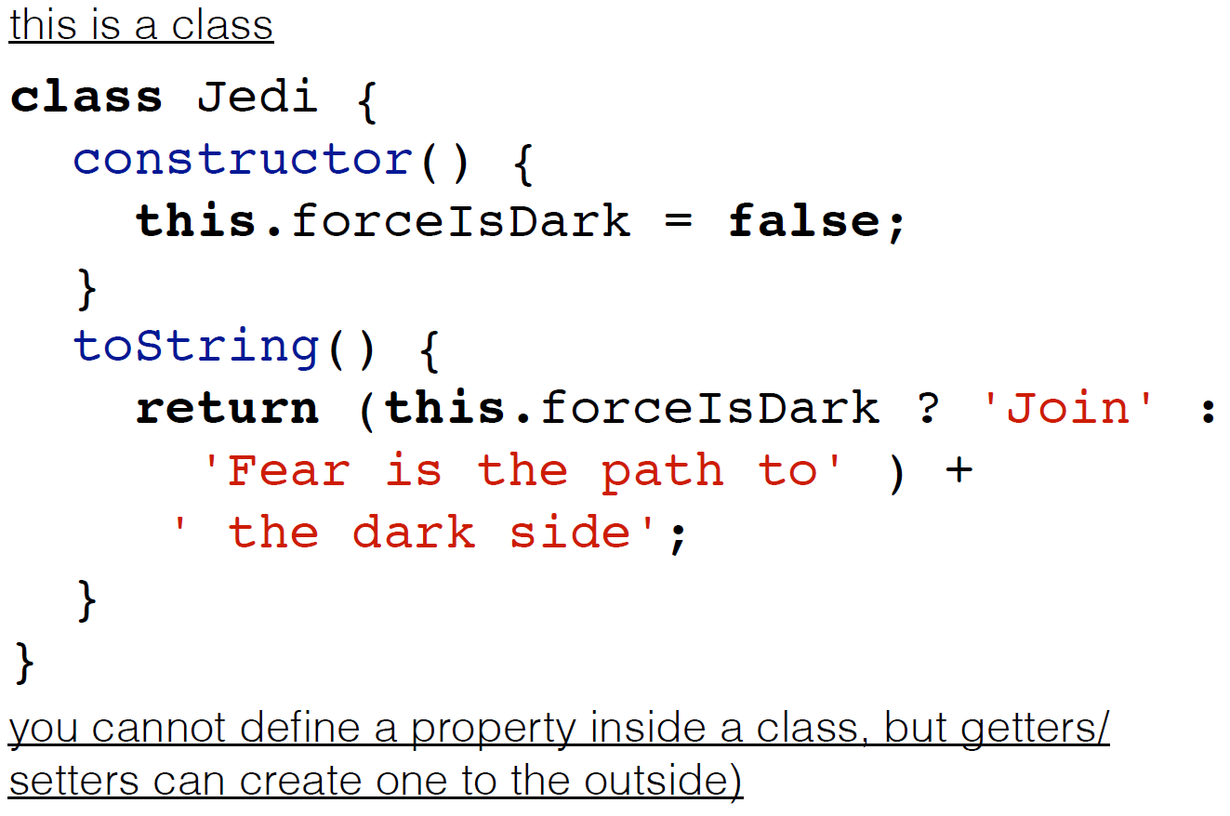
Classes

Slide 19
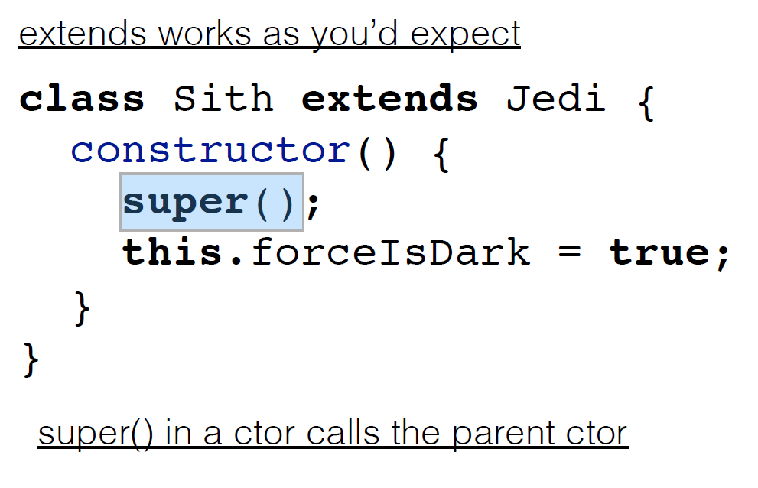
OOP: Inheritance

Slide 20
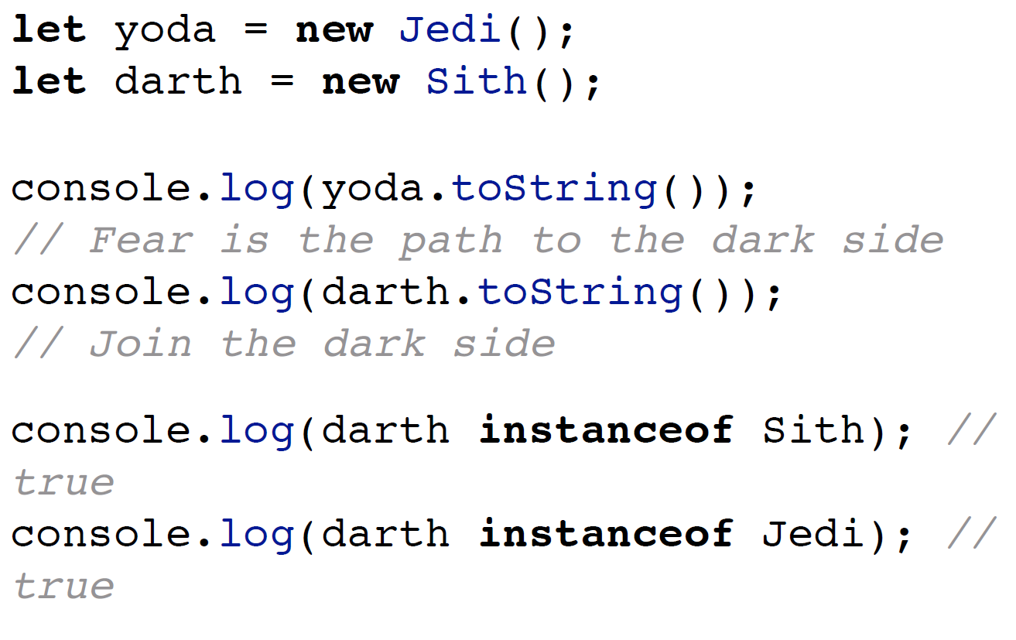
OOP: Real inheritance

Slide 21
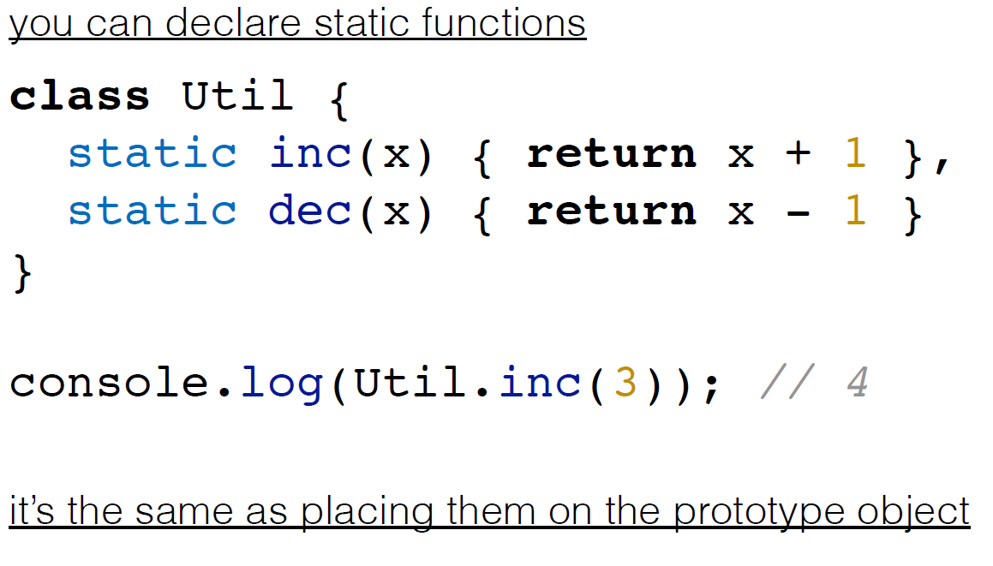
Static methods

Slide 22
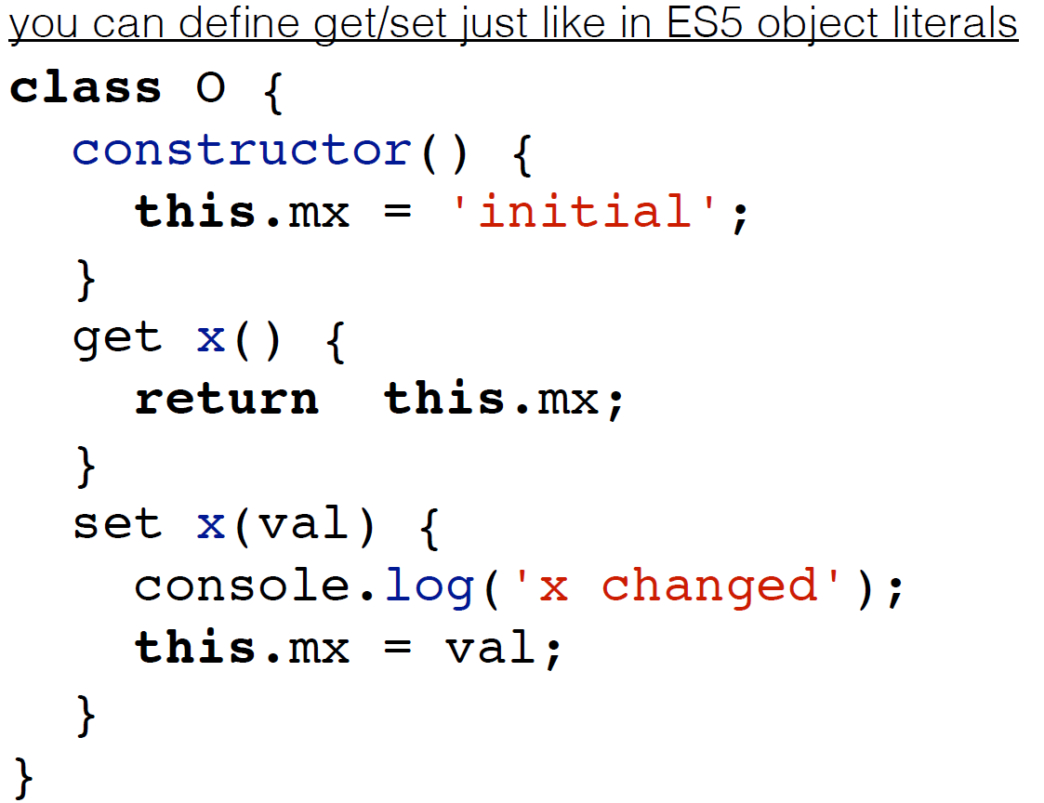
Getters and setters

Slide 23
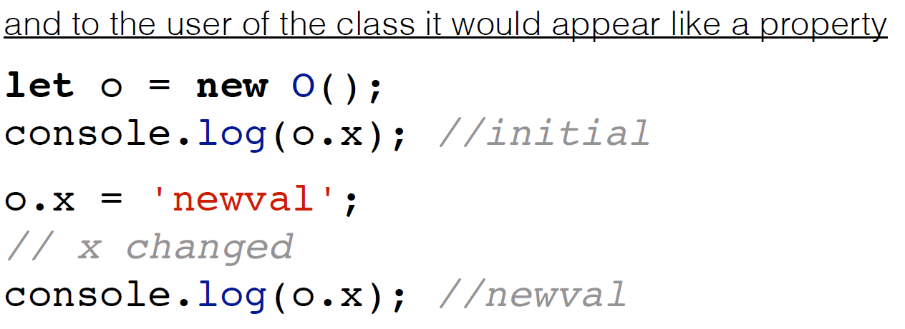
Getters and setters

Slide 24
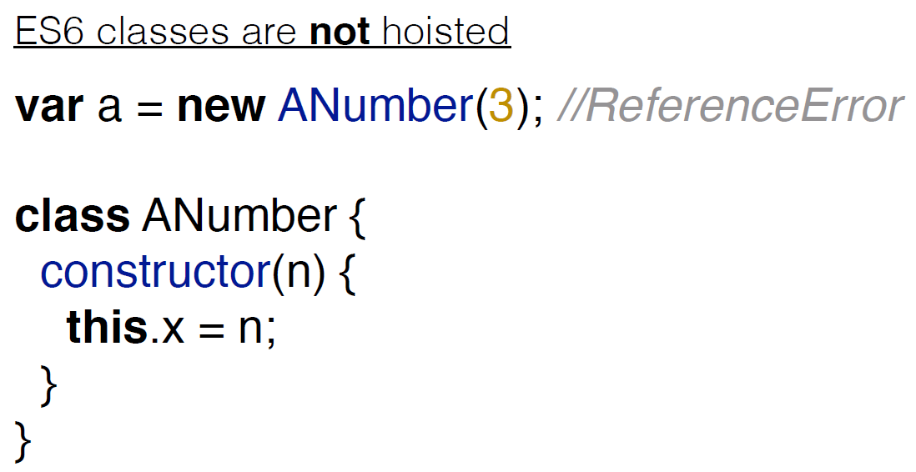
And again about hoisting

Slide 25
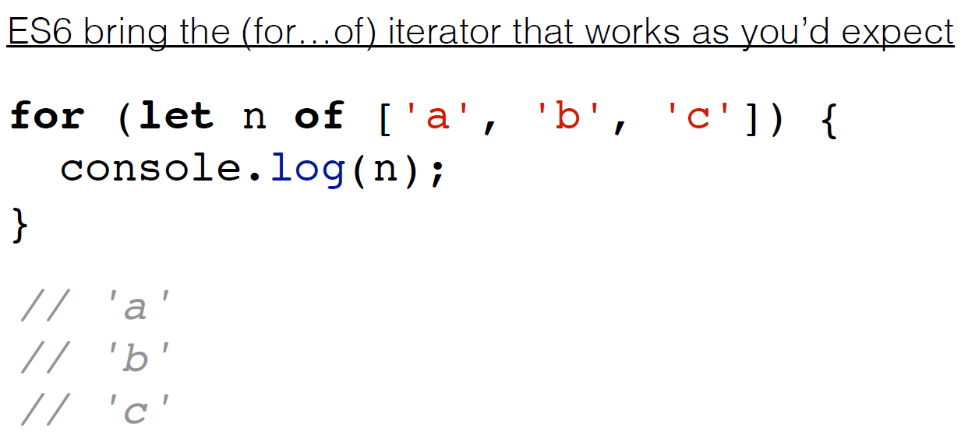
Iterator pattern

Slide 26
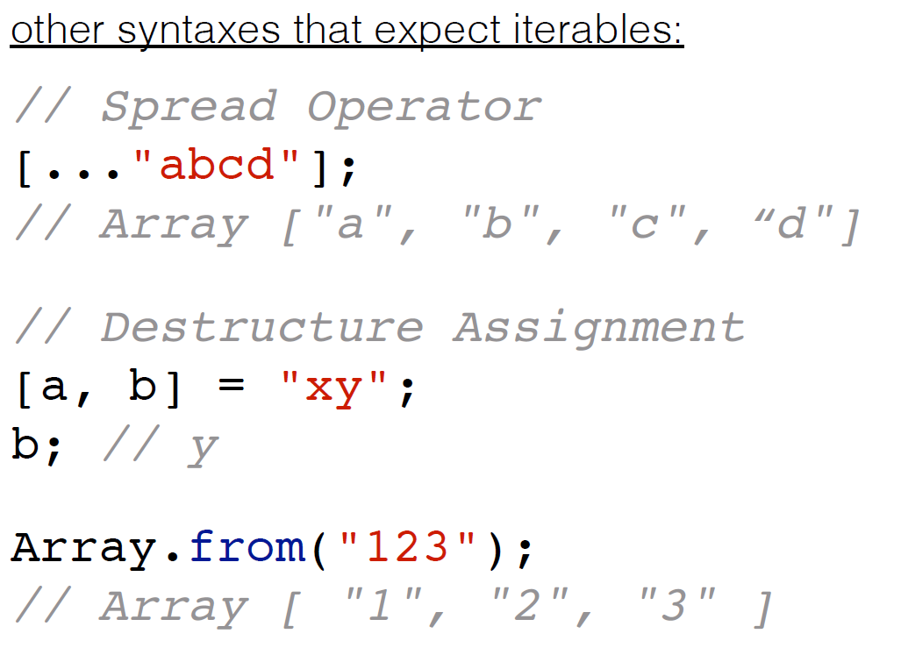
Iterator pattern implementations

Slide 27
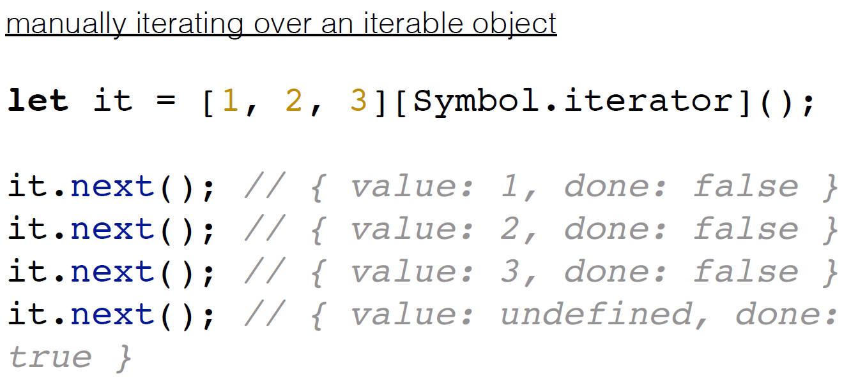
Iterator in action

Slide 28
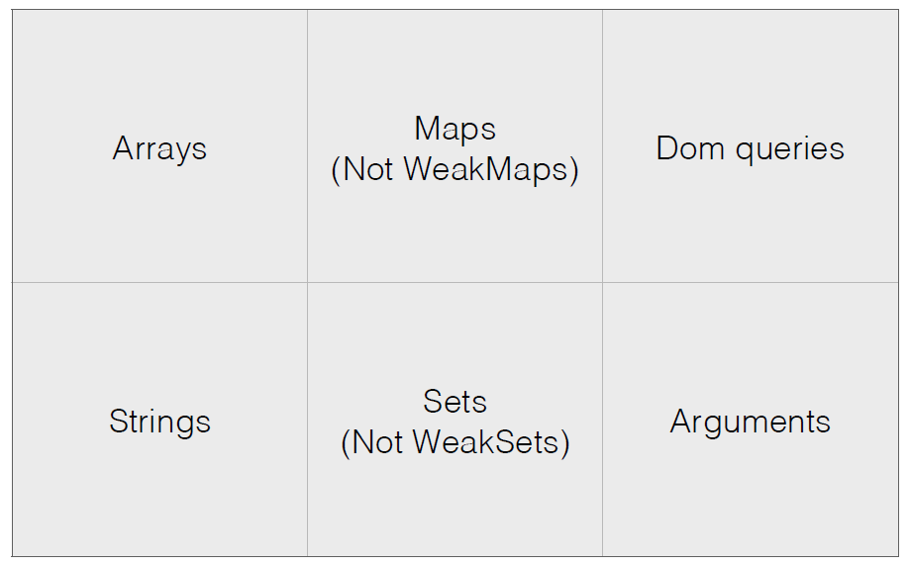
Data structures implements iterator

Slide 29
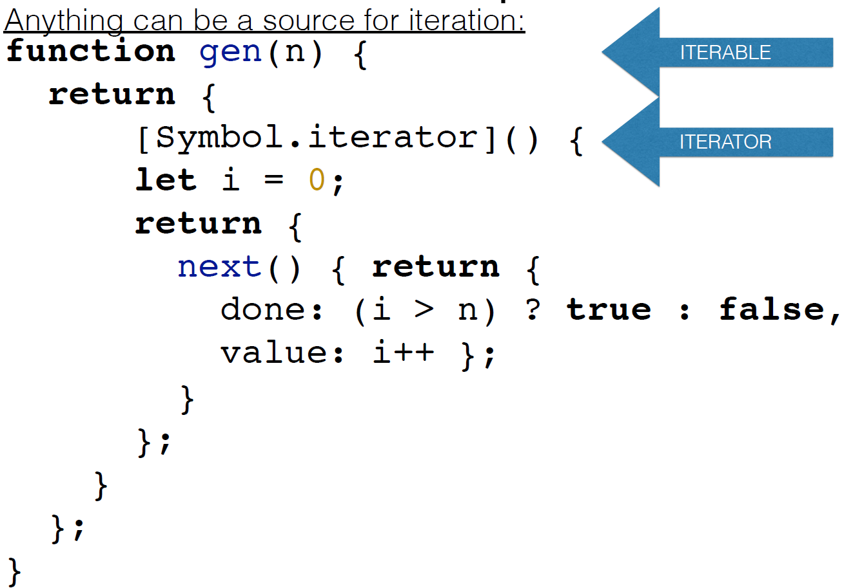
Implement iterator pattern

Slide 30
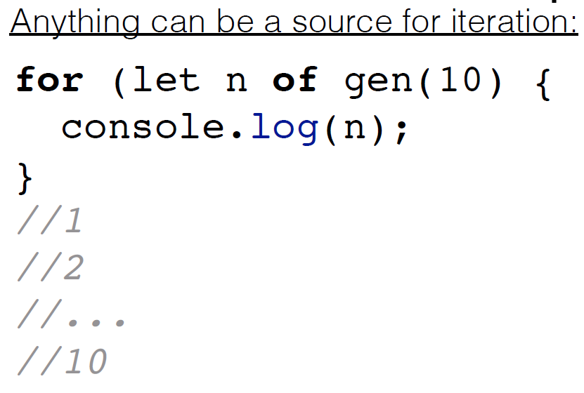
For .. of structure

Slide 31
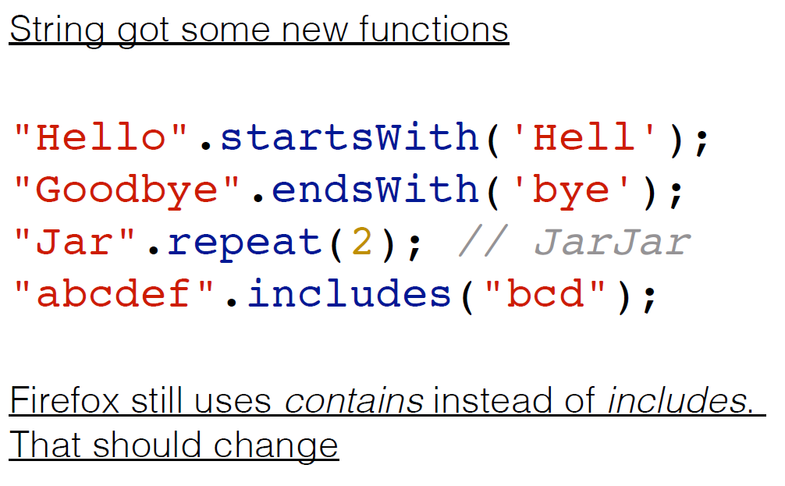
Strings

Slide 32
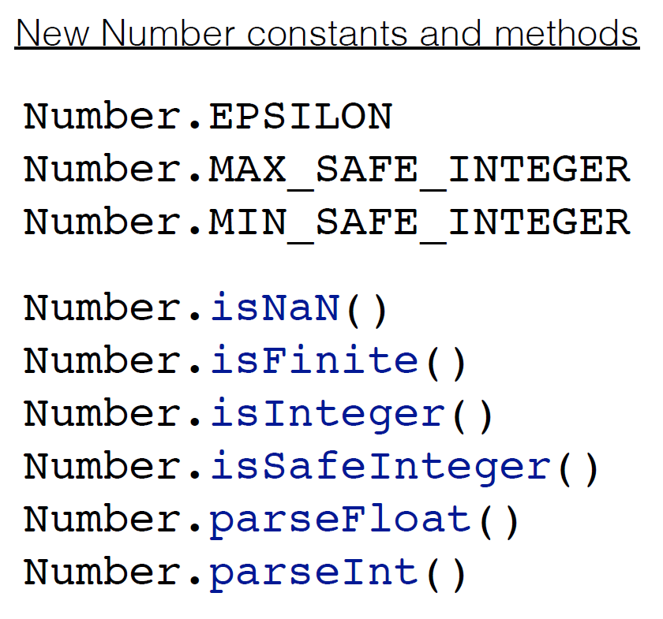
Numbers

Slide 33
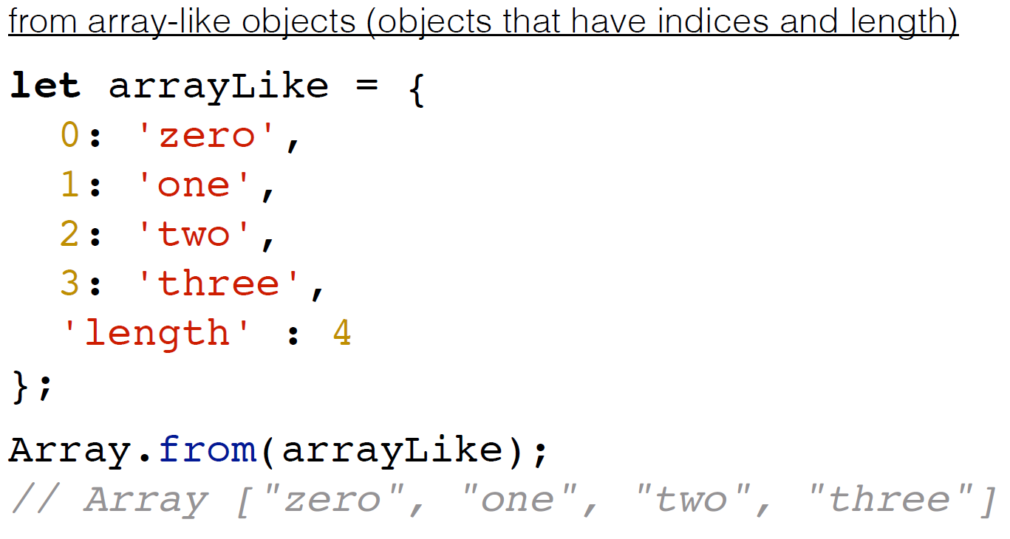
Arrays

Slide 34
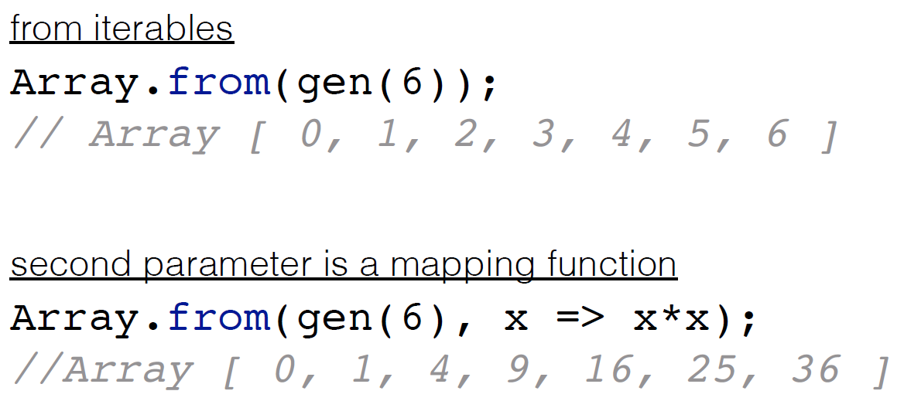
Array.from()

Slide 35
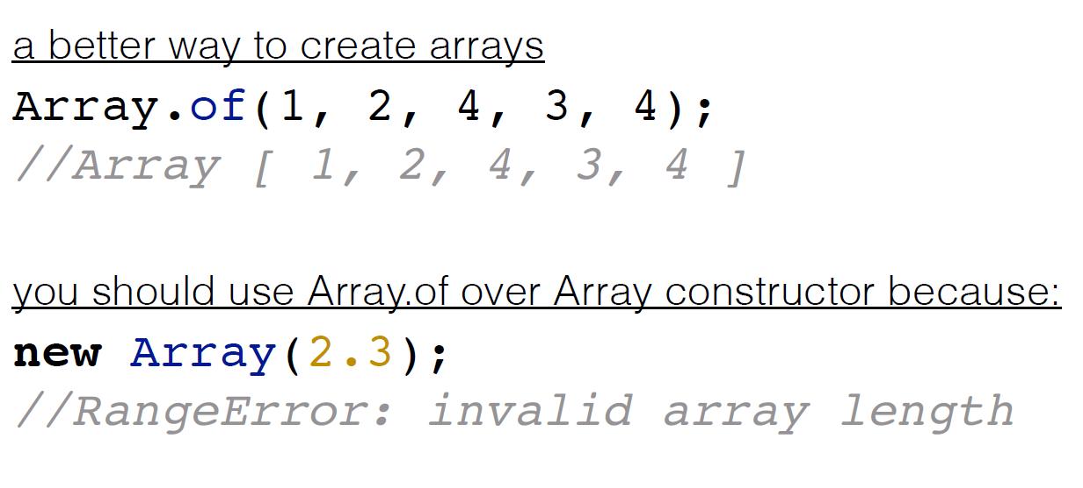
Arrays

Slide 36
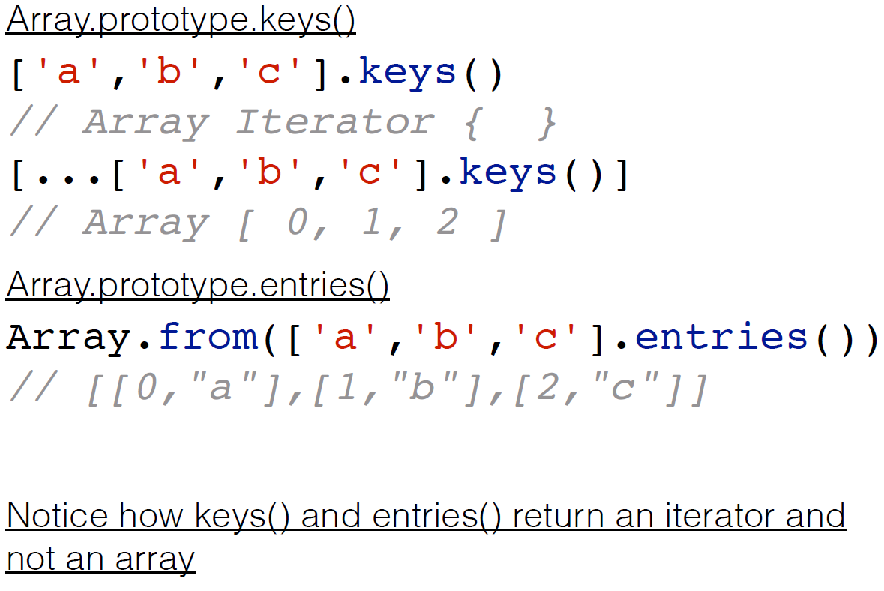
Arrays

Slide 37
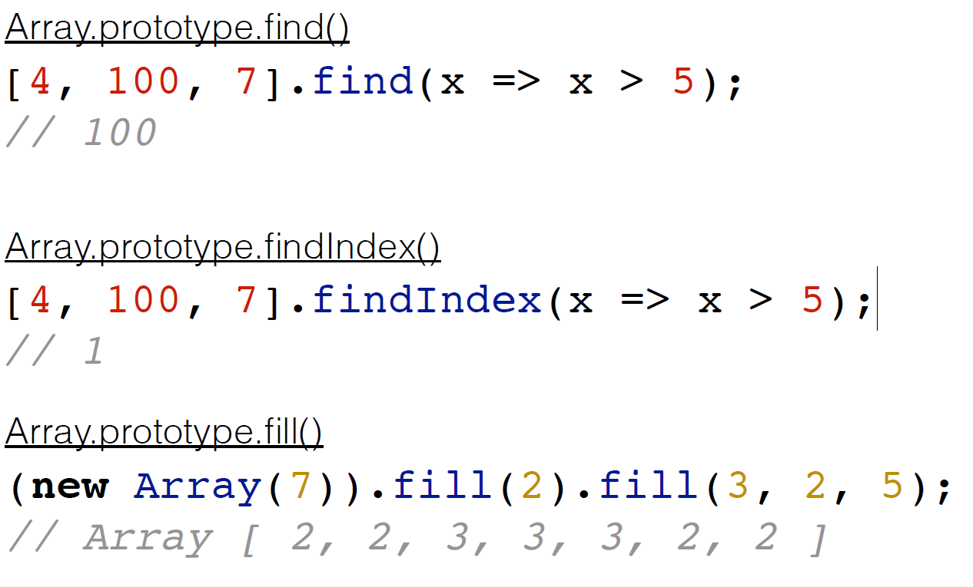
Arrays

Slide 38
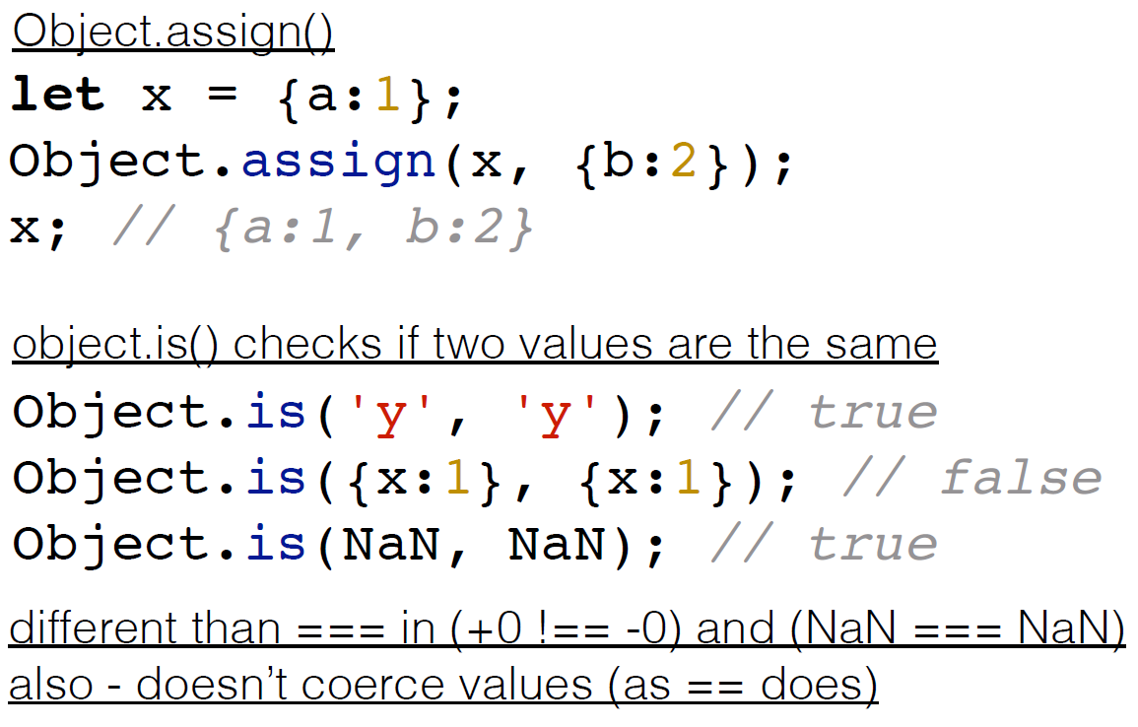
Objects

Slide 39
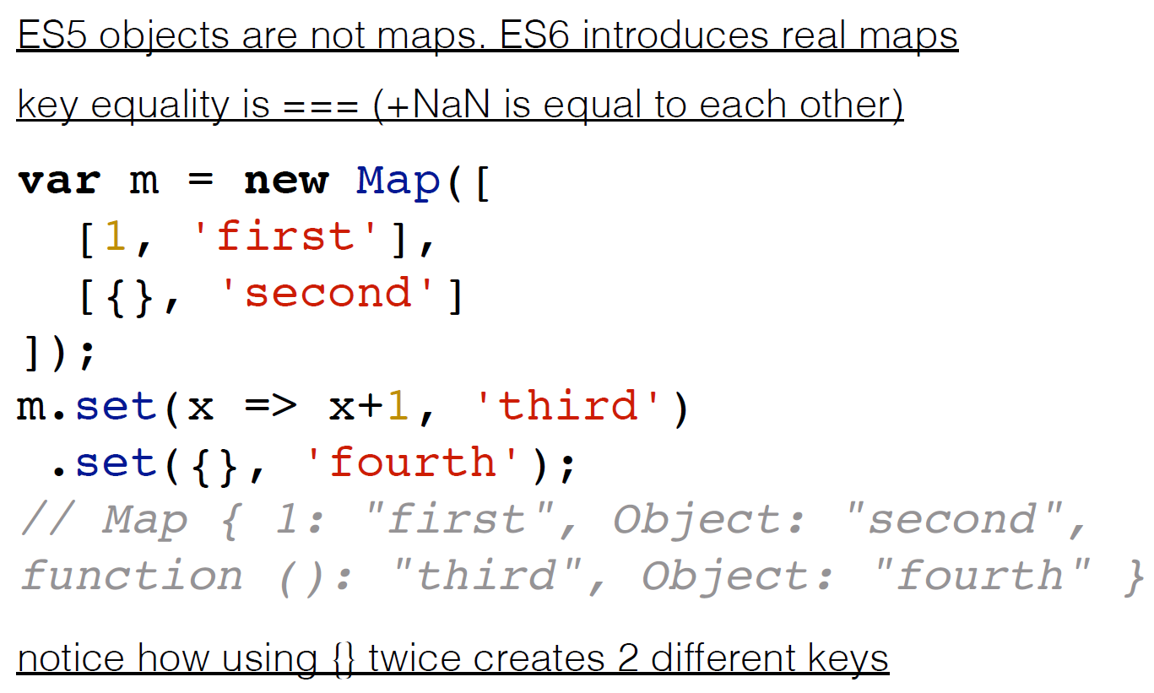
Maps

Slide 40
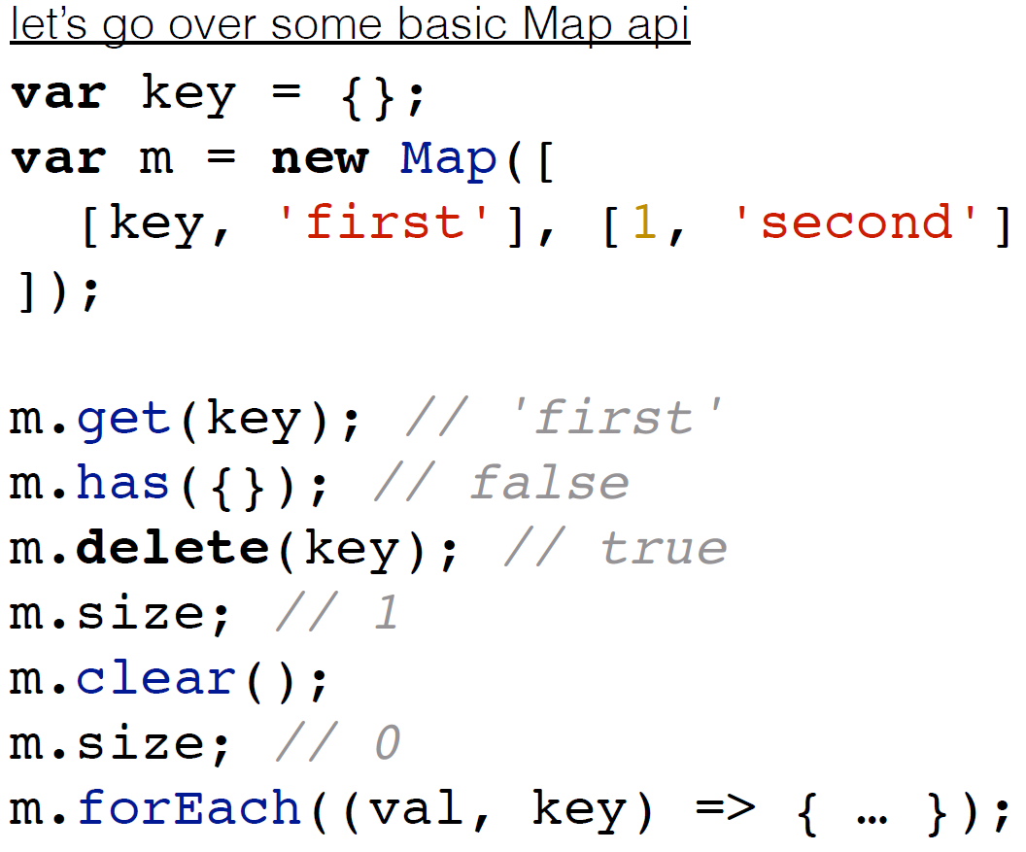
Maps

Slide 41
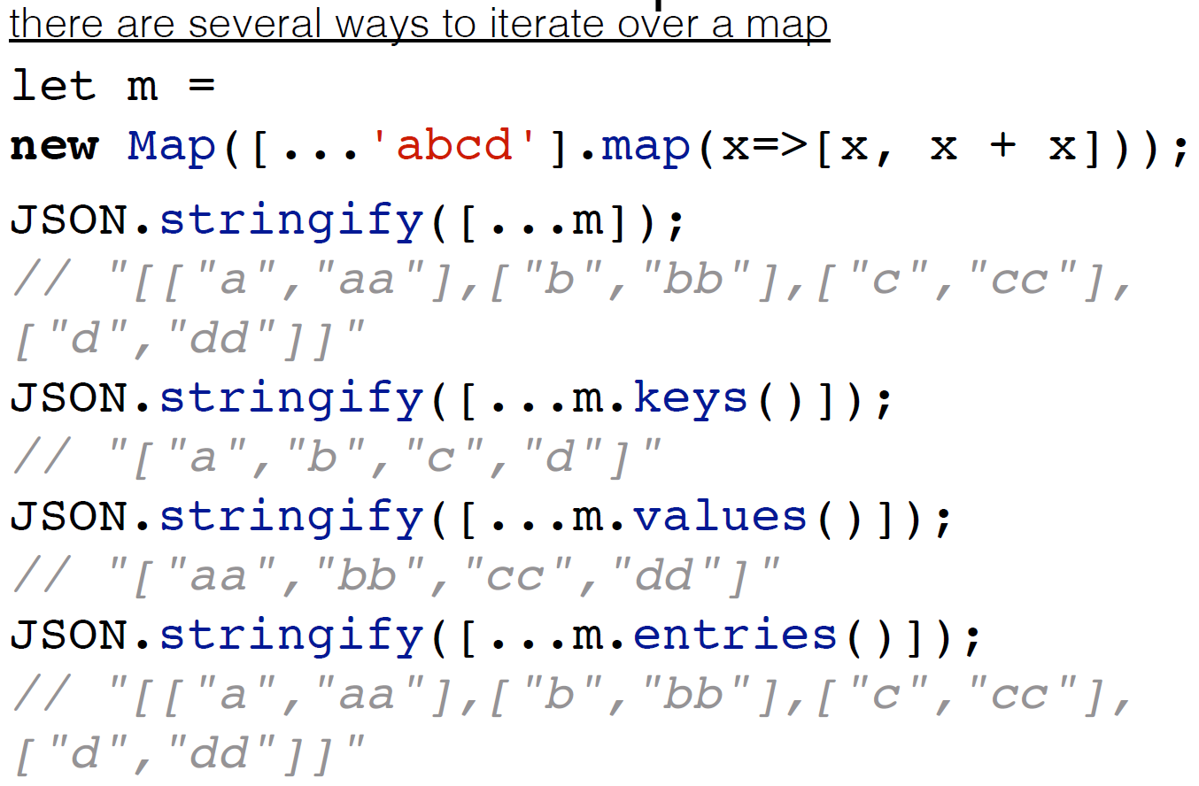
Maps

Slide 42
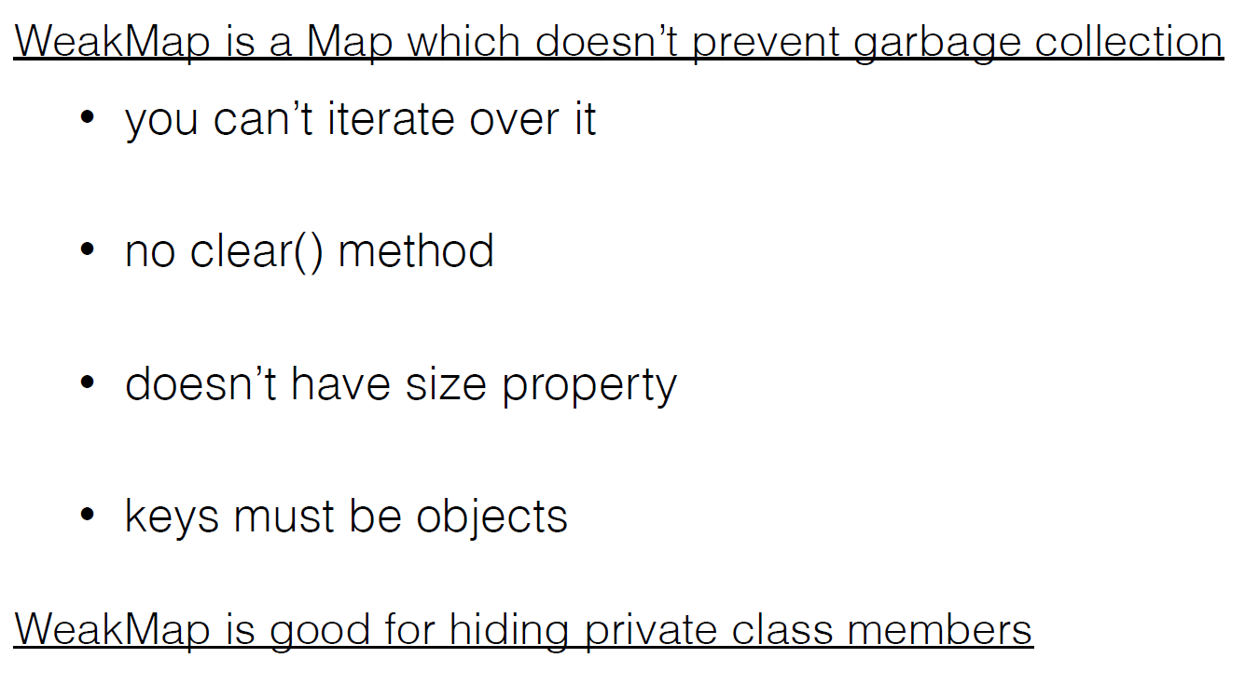
Weak maps

Slide 43
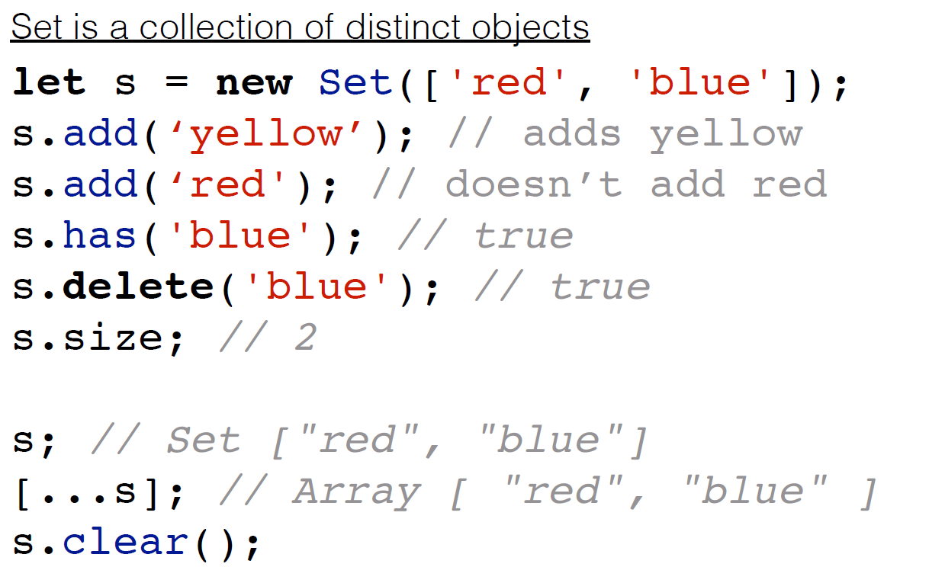
Sets

Slide 44
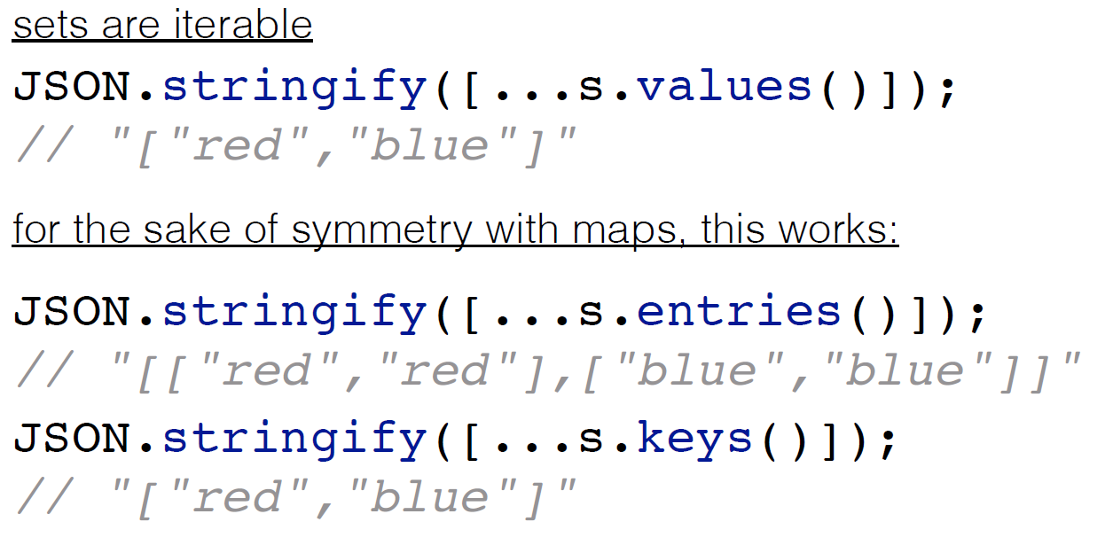
Sets

Slide 45
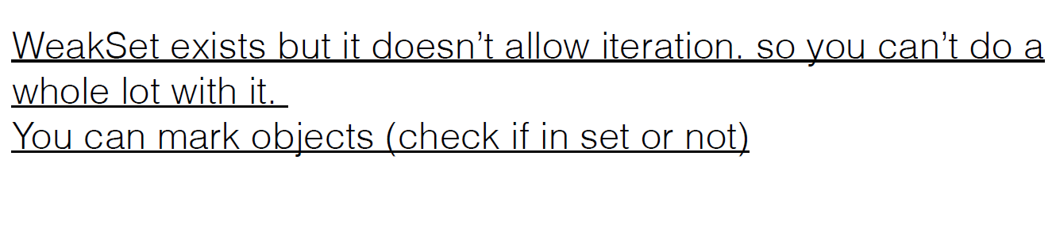
Weak sets

Slide 46
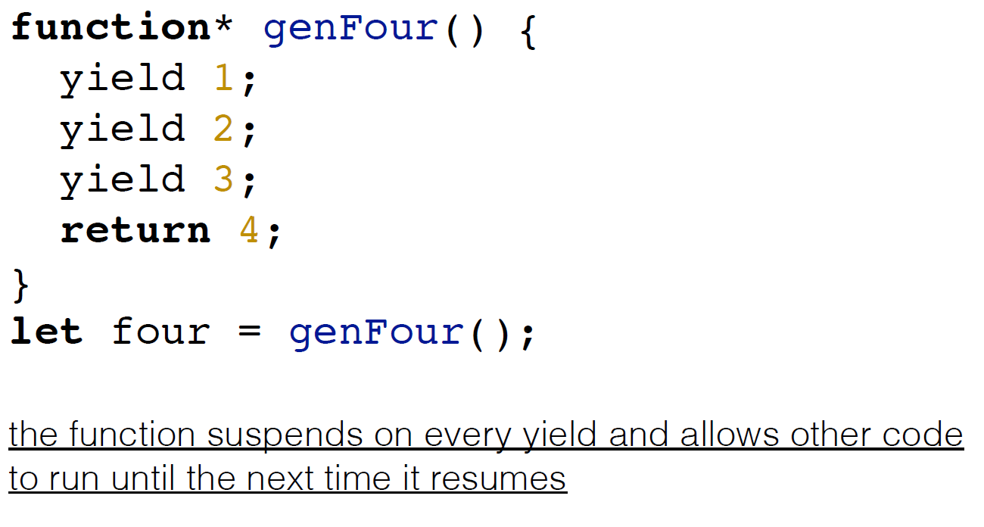
Generators

Slide 47
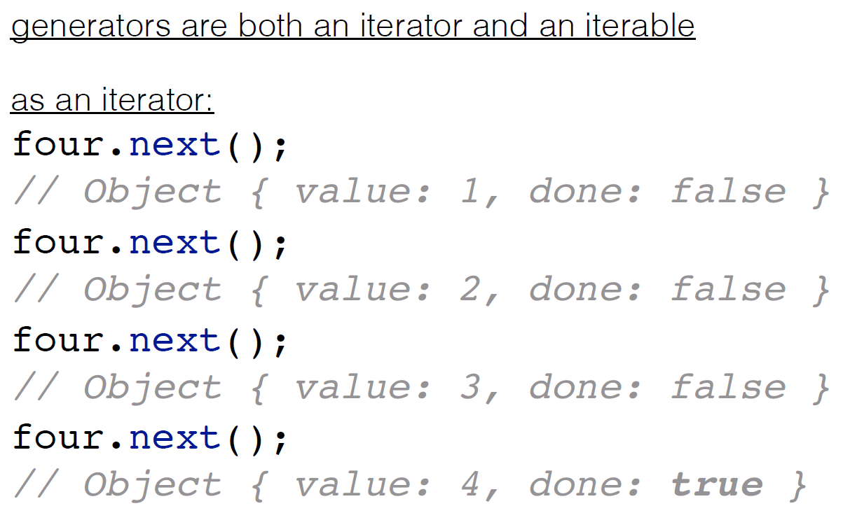
Generator in action

Slide 48
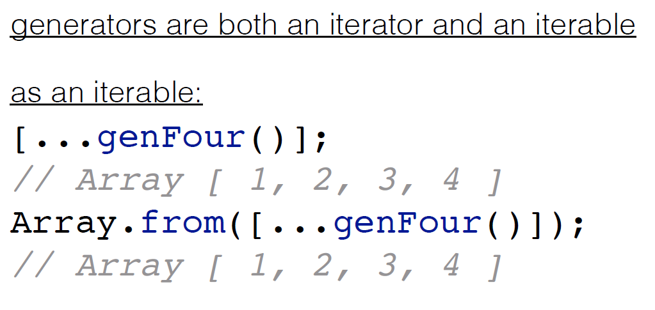
Generator in action

Slide 49
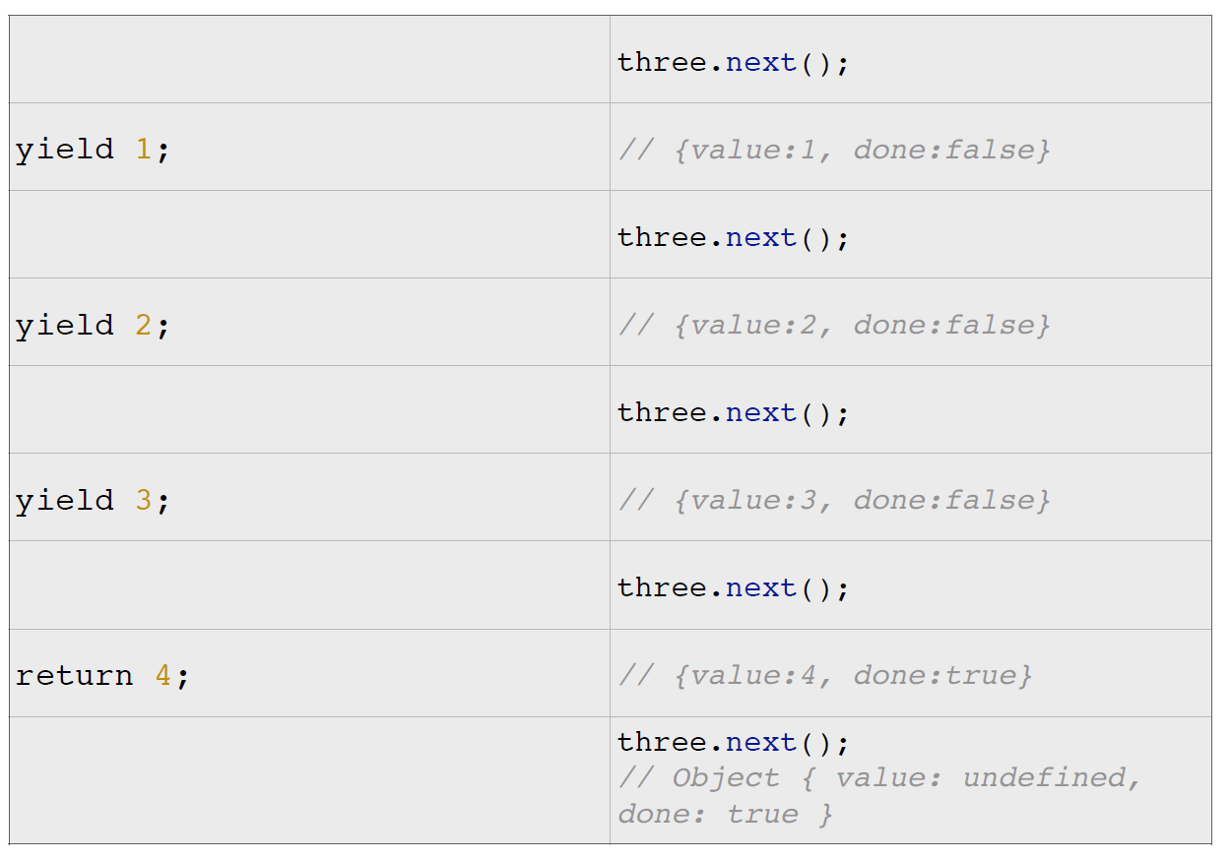
Generator in action

Slide 50
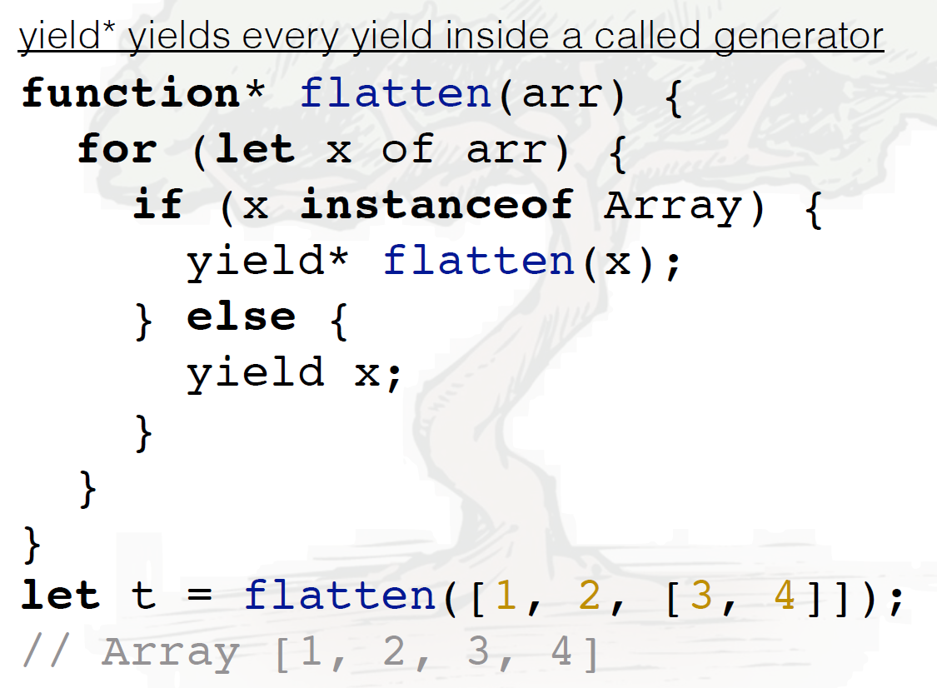
Yield*

Slide 51
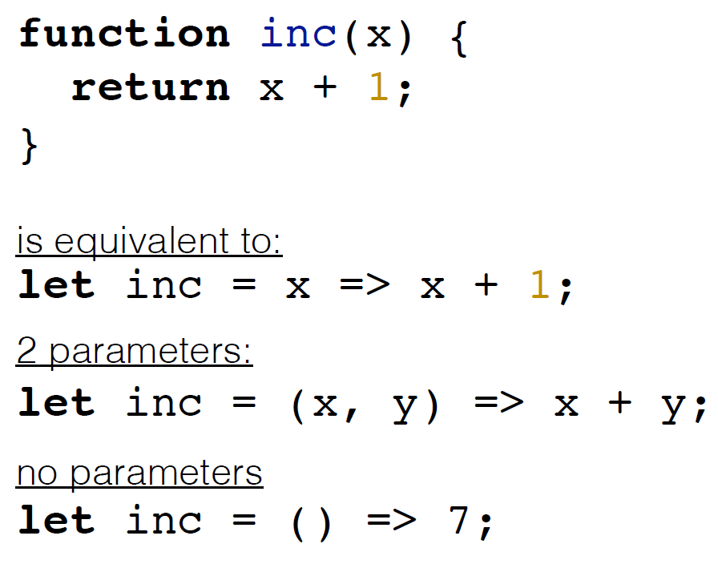
Arrow functions

Slide 52
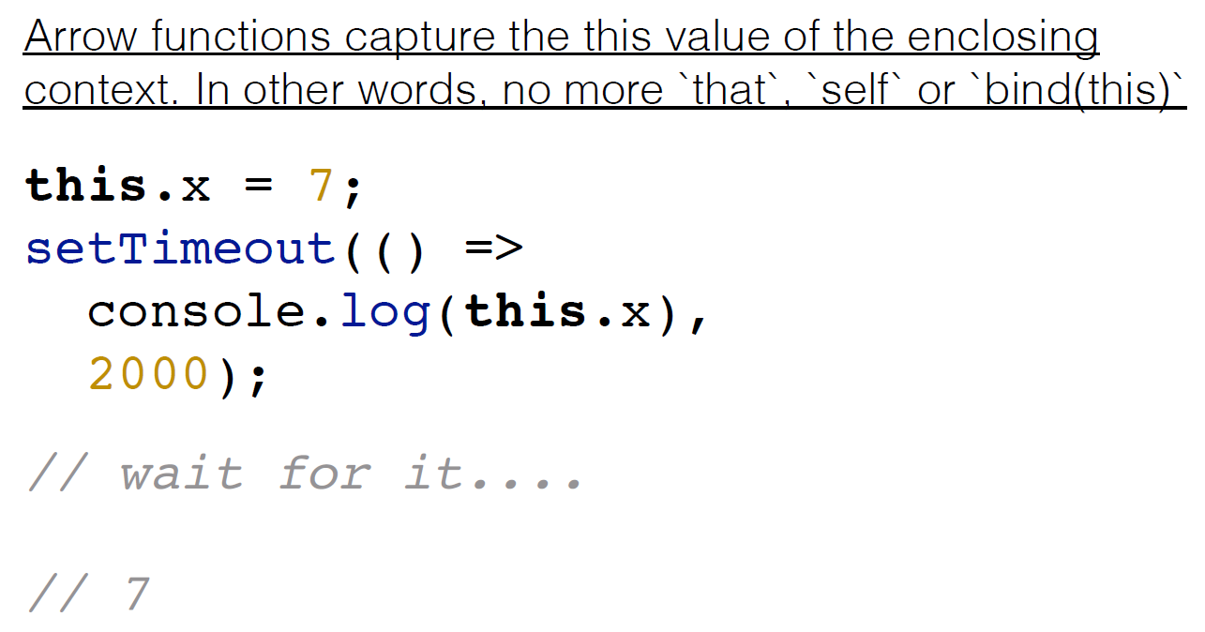
Lexical this

Slide 53

Promise

Slide 54

Promise A+ API

Slide 55

Flattering

Slide 56

Promises

Slide 57

Promises

Slide 58

Destructing

Slide 59

Destructing

Slide 60

Destructing

Slide 61

Destructing default values

Slide 62

Destructing

Slide 63

Destructing

Slide 64

Rest operator

Slide 65

Destructing

Slide 66

Spread

Slide 67

Spread

Slide 68

Modules - not for node.js

Slide 69

Modules - not for node.js

Slide 70

Modules - not for node.js

Slide 71

Modules - not for node.js

Slide 72

Proxy

Slide 73
Proxy

Slide 74
Proxy

Slide 75
Thank you for your attention

